Slide 1
NESSOS E-RISE Challenge 2012
Model-Driven Risk Analysis:
The CORAS Approach
Le Minh Sang Tran
tran@disi.unitn.it
Università degli
Studi di Trento
NESSOS E-RISE Challenge 2012 – Trento May 8, 2012

Slide 2
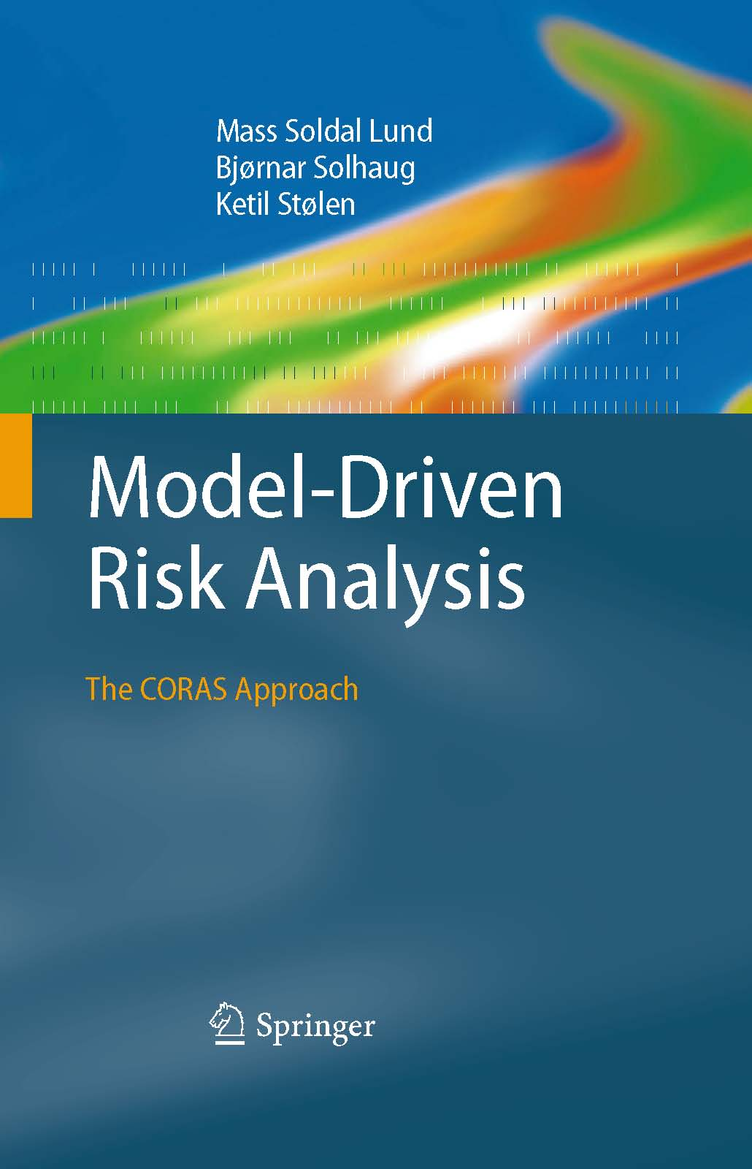
Outline
General introduction
What is Risk and Risk Analysis?
What is CORAS?
Central concepts
The risk analysis process
The eight steps of a CORAS risk analysis
Semantics
Tool support and Demo
Summary

Slide 3
What is Risk?
A possible definition of Risk:
Risk can be seen as the probable frequency (or probability) of uncertain future events that can make a probable magnitude of future loss (an undesirable outcome).

Slide 4
What is Risk Analysis?
Determining risks that can happened, why and how
Systematic use of available information to determine the level of risk
Prioritization risk by comparing the level of risk against predetermined criteria
Selection and implementation of appropriate options for dealing with risk

Slide 5
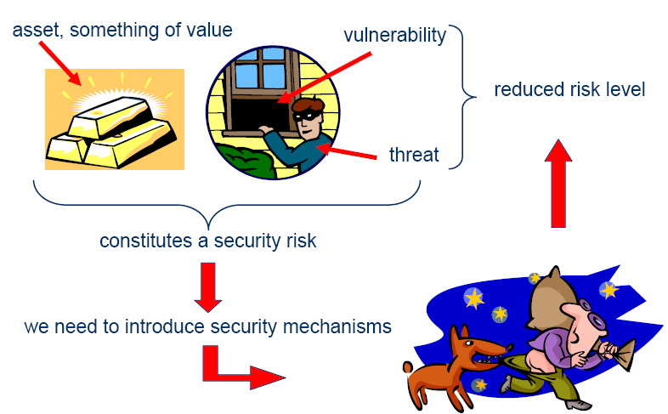
Terms

Slide 6
What is CORAS?
CORAS consists of three tightly integrated parts
A method for risk analysis
A language for risk modeling
A tool to support the risk analysis process
A stepwise, structured and systematic process
Asset-driven
Concrete tasks with practical guidelines
Model-driven
Models as basis for and input to analysis tasks
Models for documentation of results
Based on internationally established standards

Slide 7
Central Concepts
Vulnerability
Party
Asset
Threat
Treatment
Unwanted incident
Likelihood
Risk
Consequence
Notes:
Or we can call these are the elements of risk analysis

Slide 8
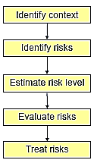
The CORAS process
Risk management process based on ISO 31000: Risk Management – Principles and Guidelines
Provides processes and guidelines for risk analysis
Notes:
Context identification: what is the focus and scope of the analysis?
Identify and value asset
Specify risk evaluation criteria: There will always be risks, but what losses can the client tolerate? (similar to requirements in system development)
2. Risk Identification: identify threat to assets through structured brainstorming, identify vulnerabilities of asset.
3. Risk evaluation: because we cannot eliminate all risks → have to determine which risks need treatment
Risk level is determined based on likelihood and consequence of the unwanted incident. (Quantitative or qualitative: loss of 1 mil euro, 25% change per 10 years, high, medium, low)
4.Risk treatment: identify treatments for unacceptable risks; evaluate and prioritize different treatments

Slide 9
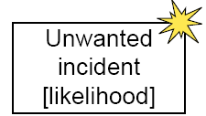
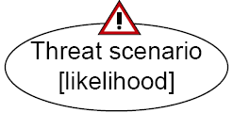
CORAS Modeling Concepts
Party:
An organization, company, person, group or other body on whose behalf a risk analysis is conducted
Asset:
Something to which a party assigns value and hence for which the party requires protection
Unwanted incident:
An event that harms or reduces the value of an asset
Vulnerability:
A weakness, flaw or deficiency that opens for, or may be exploited by, a threat to cause harm to or reduce the value of an asset
Threat:
A potential cause of an unwanted incident
Threat scenario:
A chain or series of events that is initiated by a threat and that may lead to an unwanted incident
Treatment (Treatment Scenario):
An appropriate measure to reduce risk level
Risk:
The likelihood of an unwanted incident and its consequence for a specific asset
Notes:
This slide only gives definitions, we can skip this

Slide 10
Risk modeling
The CORAS language consists of five kinds of diagrams
Asset diagrams
Threat diagrams
Risk diagrams
Treatment diagrams
Treatment overview diagrams
Each kind of diagram supports specific steps of the risk analysis process
Three further kinds of diagram for specific needs
High-level CORAS diagrams
Dependent CORAS diagrams
Legal CORAS diagrams

Slide 11
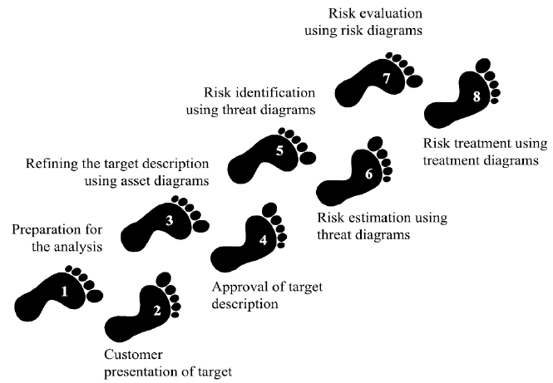
The eight steps of a CORAS risk analysis

Slide 12
The eight steps of a CORAS risk analysis
Preparation for the analysis
Customer presentation of the target
Refining the target description using asset diagrams
Approval of the target description
Risk identification using threat diagrams
Risk estimation using threat diagrams
Risk evaluation using risk diagrams
Risk treatment using treatment diagrams

Slide 13
Step 1: Preparation for the analysis
Objective: do the necessary initial preparations prior to the actual startup of the analysis
Tasks:
Roughly setting the scope and focus
Informing the customers of their responsibilities
People should participate:
Target team (representatives of the customer)
Analysis team
Modeling:
Modeling is not part of this step

Slide 14
Example
Alice is a PhD student. She signed a contract to receive funding from the Big Corporation for her thesis topic.
Alice’s thesis relates to business stuff of the Big Corporation.
Alice’s often works on her home laptop. She is living with Ann, her sister. Alice and Ann use the same laptop.

Slide 15
Step 2: Customer presentation of the target
Objective: achieve an initial understanding of the “target” of risk analysis
This step involves an introductory meeting
Agenda for this meeting: to get the representatives of the client to present:
Their overall goals of the analysis
The target they wish to have analyzed
Hence, during the initial step the analysts will gather information based on the customer’s presentations and discussions

Slide 16
Step 2: Customer presentation of the target
Tasks:
The CORAS risk analysis method is introduced
Customer presents the their goals and target
The focus of the analysis is set
The meetings and workshops are planned
People should participate:
Target team (representatives of the customer)
Analysis team
Modeling:
Informal drawings, pictures or sketches on a blackboard
Or supplemented with more formal modeling techniques (such as UML, …)

Slide 17
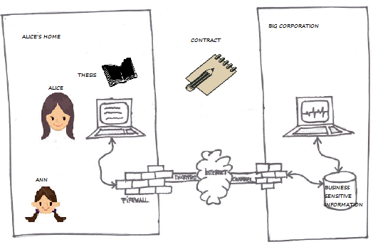
Example: Customer presentation of the target
Customer’s goals and target:
Alice is worried about losing the work she has done on her thesis
Big Corporation worried that sensitive business information with reach its competitors
Hence, they decide to do security risk analysis to determine the risk level is acceptance

Slide 18
Step 3: Refining the target description using asset diagrams
Objective: ensure a common and more precise understanding of the target analysis, including its scope, focus, and main assets
Involve a separate meeting between analysis team and representatives of customer
The first threats, vulnerabilities, threat scenarios and unwanted incidents are identify

Slide 19
Step 3: Refining the target description using asset diagrams
Tasks:
The target as understood by the analyst
The assets are identified
A high-level analysis is conducted
People should participate:
Target team
Analysis team
Modeling:
Asset diagrams

Slide 20
Step 3: Refining the target description using asset diagrams
Artifacts produced:
Asset diagram
Preliminary list of Unwanted incidents
What have to do:
Asset Analysis
Identify involving parties
Identify assets of each party intend to protect
The “THINGS” that are valuable
Relations between assets
Harm in one asset might harm also other assets.
High level risk analysis → Preliminary Unwanted incidents
Notes:
Party: An organization, company, person, group or other body on whose behalf a risk analysis is conducted

Slide 21
Example: Identify Party and Asset
Party:
Alice, Big Corporation (BC)
Asset:
PhD thesis
Business sensitive information
Alice’s reputation
BC’s reputation
Compliance with contract between Alice and BC

Slide 22
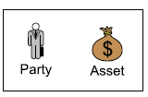
Example: Asset diagram
We use an Asset diagram to model the parties involved in the analysis, which assets they want to protect, and whether harm to one asset may cause harm to any of the others.
Notions to be used in Asset Diagram

Slide 23
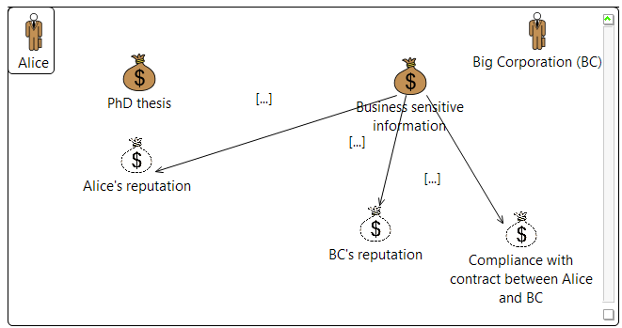
Example: Asset diagram
Notes:
An indirect asset is an asset that, w.r.t. the target and scope of the analysis, is harmed only via harm to other assets. A direct asset is an asset that is not indirect.

Slide 24
High level Risk analysis
Preliminary Unwanted Incidents
Who/ What is the cause? | How? What may happen? What does it harm? | What makes this possible?
Alice | Deletes the thesis by mistake | No backup
Laptop | Crashes and the last working hours is lost | Old laptop
Hacker | Gains access to business sensitive information and sells it to competitors | Lack of security at home

Slide 25
Step 4: Approval of the target description
Objective: decide a ranking of the assets; establish scales for estimating risks and criteria for evaluate risks
Notes:
Party: An organization, company, person, group or other body on whose behalf a risk analysis is conducted

Slide 26
Step 4: Approval of the target description
Tasks:
Assets may be ranked (optional)
Consequences scales must be set for each direct asset
A likelihood scale must be defined
Risk functions must be defined
Risk evaluation criteria must be defined
People should participate:
Target team
Analysis team
Modeling:
Modeling is not part of this step
Notes:
Risk function = as a function of likelihood and consequence

Slide 27
Step 4: Approval of the target description
Artifacts produced:
Likelihood and Consequence scales
Risk function
Risk evaluation criteria
What have to do:
Define:
Likelihood scale and its description
Consequence scale for each asset
Risk function is determined
Agree on Risk evaluation criteria

Slide 28
Example: Define Likelihood scale
Likelihood scale
Likelihood | Description
Certain | A very high number of similar occurrences already on record; has occurred a very high number
Likely | A significant number of similar occurrences already on record; has occurred a significant
Possible | Several similar occurrences on record; has occurred more than once
Unlikely | Only very few similar incidents on record when considering a large volume of transaction
Rare | Has never occurred yet throughout the total lifetime of the system
Notes:
Likelihood:
The frequency or probability of something to occur

Slide 29
Example: Define Likelihood scale
Likelihood scale
Likelihood | Description
Rarely | Less than once per ten years
Sometimes | Two or five times per year
Regularly | .. (determined by target team with the suggestions from analysis team)…
Often | ..
… | ..

Slide 30
Example: Define Consequence scale
Consequence scale (for direct Asset: PhD thesis)
Consequence | Description
Catastrophic | Entire PhD thesis is lost and cannot recover
Serious | Half of the PhD thesis is lost
Moderate | A small number of thesis files is lost
Minor | Only one figure of thesis is lost
Insignificant | Nothing lost
Notes:
Consequence:
The impact of an unwanted incident on an asset in terms of harm or reduced asset value

Slide 31
Example: Define Consequence scale
Consequence scale (for direct Asset: Business sensitive information)
Consequence | Description
Catastrophic | Business sensitive information is lost and cannot be recovered. This makes Big Corporation out of business
Serious | Half of the Business sensitive information is lost and can potentially make Big Corporation out of business
Moderate | .. (determined by target team with the suggestions from analysis team)…
Minor | …
Insignificant | …
Notes:
Consequence:
The impact of an unwanted incident on an asset in terms of harm or reduced asset value

Slide 32
Example: Risk Function and evaluation criteria
Determine level of risk as a function of likelihood and consequence
Risk Function (PhD thesis)
Consequence/ Likelihood | Insignificant | Minor | Moderate | Serious | Catastrophic
Rare
Unlikely
Possible
Likely
Certain
 | Acceptable
 | Monitor
 | Need to be treated

Slide 33
Example: Risk Function and evaluation criteria
Determine level of risk as a function of likelihood and consequence
Risk Function (Business sensitive information)
Consequence/ Likelihood | Insignificant | Minor | Moderate | Serious | Catastrophic
Rare
Unlikely
Possible
Likely
Certain
 | Acceptable
 | Monitor
 | Need to be treated

Slide 34
Step 5: Risk Identification using threat diagrams
Objective: identify the risks that must be managed; determined where, when, why, how they may occur
Notes:
Party: An organization, company, person, group or other body on whose behalf a risk analysis is conducted

Slide 35
Step 5: Risk Identification using threat diagrams
Tasks:
Identify and document risks through the identification and documentation of unwanted incidents, threats, threat scenarios and vulnerabilities
People should participate:
Target team
Analysis team
Modeling:
Threat diagrams
Notes:
Risk function = as a function of likelihood and consequence

Slide 36
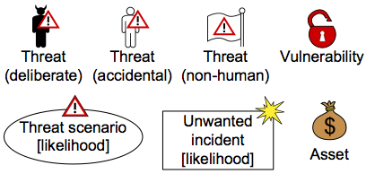
Step 5: Risk Identification using threat diagrams
Artifacts produced:
Threat diagram
How:
Identify risk that might harm clients’ assets
How a threat exploits a vulnerability to cause an unwanted incident that harms the client’s asset
(proposed) Sub steps:
Identify Assets and Threats
Identify Unwanted Incidents
Identify Threat Scenarios
Identify Vulnerabilities
Notions to be used in Threat diagram

Slide 37
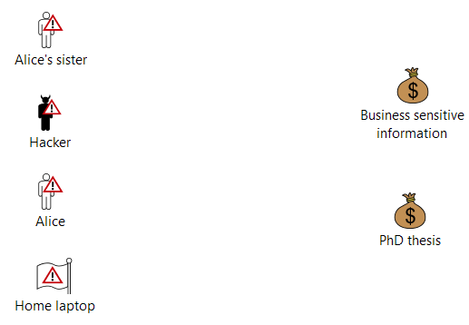
How: Identify Threats
Answer the question: “What are the threats?”
Hints:
“Accidental threat”: users/ roles inside the system
Attackers from outside: “deliberate threat”

Slide 38
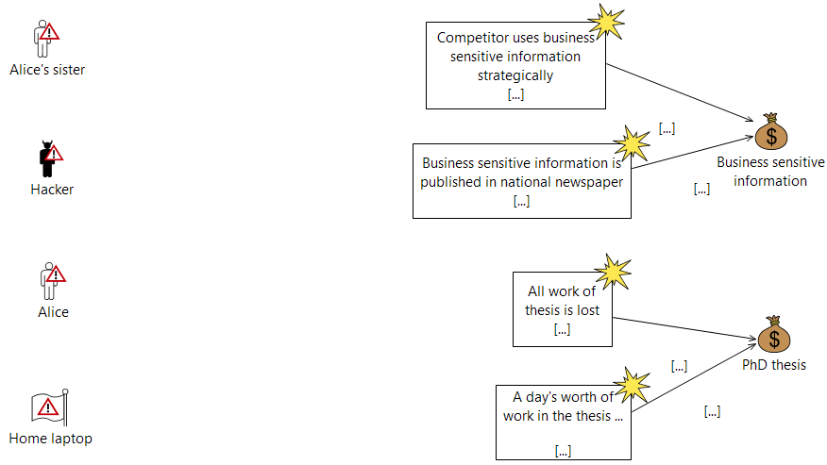
How: Identify Unwanted Incidents
Answer the question:
What (unwanted incidents) do we fear will happen?
“impact” relation

Slide 39
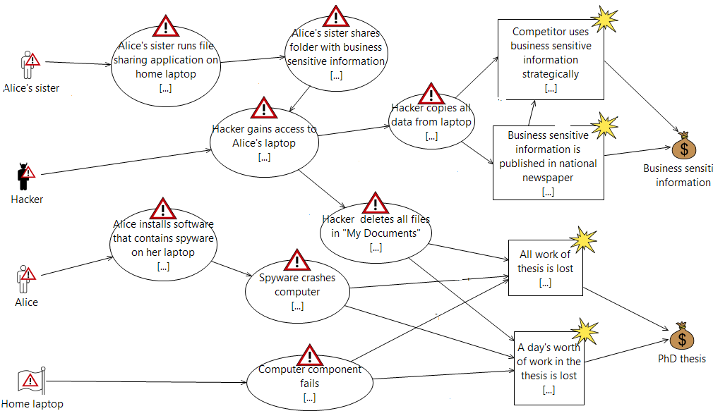
How: Identify Threat Scenarios
Answer the question:
How does it happen? It happens by which threat scenarios?
“impact”
“initiate”
“leads to”

Slide 40
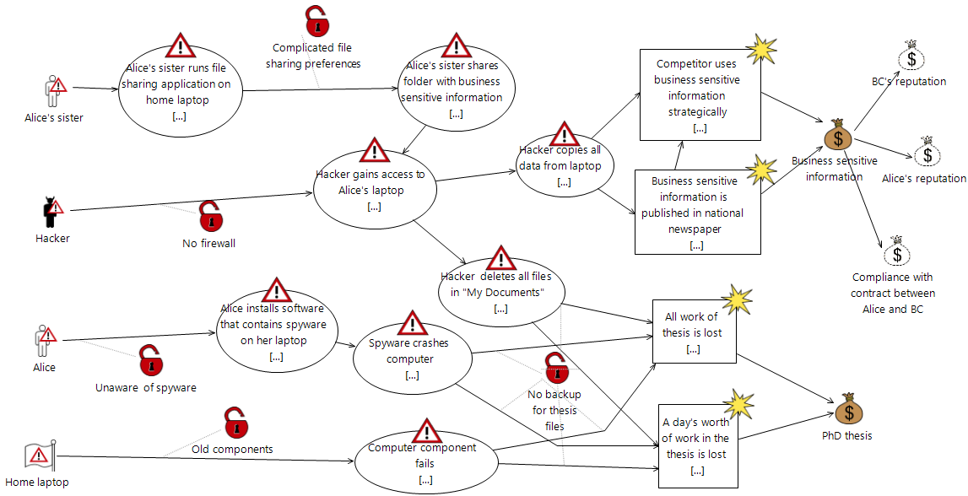
How: Identify Vulnerabilities
Answer the question:
Which vulnerabilities makes this possible?
“vulnerability target”

Slide 41
Step 6: Risk estimation using threat diagrams
Objective: determine risk level of the identified risks
Notes:
Party: An organization, company, person, group or other body on whose behalf a risk analysis is conducted

Slide 42
Step 6: Risk estimation using threat diagrams
Tasks:
Provide likelihood estimated for unwanted incidents
Estimates the consequences of the unwanted incidents
Estimate risk level based on the estimation of likelihood and consequences
People should participate:
Target team
Analysis team
Modeling:
Risk estimation on threat diagram
Notes:
Risk function = as a function of likelihood and consequence

Slide 43
Step 4: Risk estimation
Artifacts produced:
Completed Threat diagrams with Likelihood and Consequences assigned
How: base on Likelihood and Consequence approved in Step 4
Assign likelihoods to each Unwanted Incidents and each Threat Scenario
Assign consequences to each “impact” relation

Slide 44
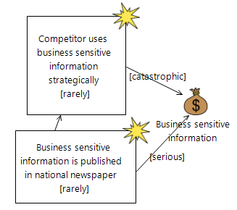
Example: Assign Likelihood and Consequence

Slide 45
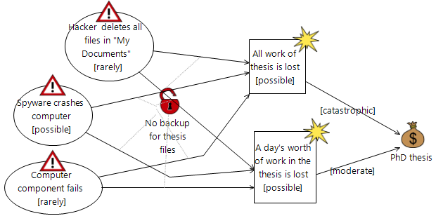
Example: Assign Likelihood and Consequence

Slide 46
Step 7: Risk evaluation using Risk diagram
Objective: decide which of the identified risks are acceptable and which must be further evaluated for possible treatment
Notes:
Party: An organization, company, person, group or other body on whose behalf a risk analysis is conducted

Slide 47
Step 7: Risk evaluation using Risk diagram
Tasks:
Likelihood and consequence scales should be confirmed or adjusted
An overview of risks is given in risk diagrams
The identified risks are evaluated
People should participate:
Target team
Analysis team
Modeling:
Risk diagram with evaluation results
Notes:
Risk function = as a function of likelihood and consequence

Slide 48
Step 7: Risk evaluation using Risk diagram
Artifacts produced:
Completed Risk Function
Risk Diagram with evaluation result
How:
Evaluate which risks are acceptable and which are not
Enter the risks into the Risk Function (from step 4)
Give overview of the risks by summarizing risks in the Risk Diagram

Slide 49
Example: Completed Risk Function
Risk Matrix (PhD thesis)
Consequence/ Likelihood | Insignificant | Minor | Moderate | Serious | Catastrophic
Rarely
Unlikely
Possible |  |  | A day’s worth of work on the thesis is lost |  | All work on thesis is lost
Likely
Certain

Slide 50
Example: Completed Risk Function
Risk Matrix (Business sensitive information)
Consequence/ Likelihood | Insignificant | Minor | Moderate | Serious | Catastrophic
Rarely |  |  |  | Business sensitive information is published in national newspaper | Competitors uses Business sensitive information strategically
Unlikely
Possible
Likely
Certain

Slide 51
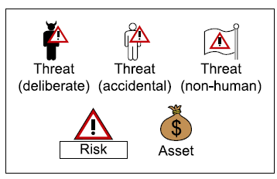
Summarizing the Risk picture
We use Risk diagram to show how Threats pose Risks to the Assets
Notions to be used in Risk diagram:

Slide 52
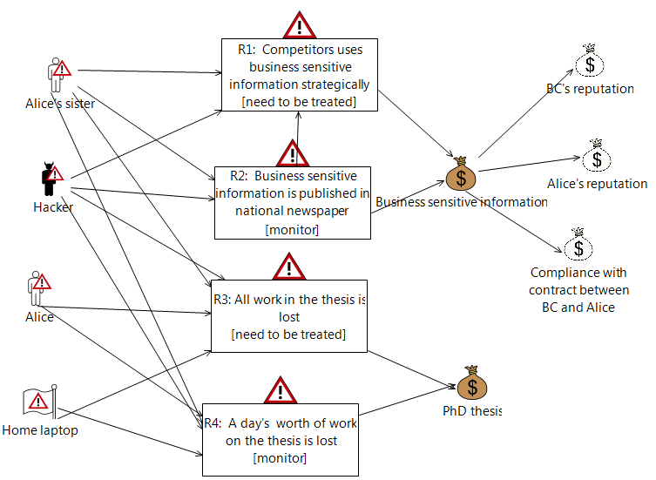
Example: Risk diagram

Slide 53
Step 8: Risk treatment using treatment diagram
Objective: identify cost effective treatments for the unacceptable risks
Notes:
Party: An organization, company, person, group or other body on whose behalf a risk analysis is conducted

Slide 54
Step 8: Risk treatment using treatment diagram
Tasks:
Identify treatments to unacceptable risks
Estimate the cost-benefit of each treatment and decide which one to implement
People should participate:
Target team
Analysis team
Modeling:
Treatment diagrams
Treatment overview diagrams
Notes:
Risk function = as a function of likelihood and consequence

Slide 55
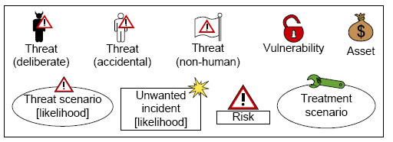
Step 8: Risk treatment using treatment diagram
Artifacts produced:
Treatment diagram (=Threat diagram with Treatment added)
(or also Treatment Overview diagram)
How:
Identify Treatment Scenario:
What can we do to reduce the risks to an acceptable (or monitor) level?
Create Treatment diagram:
Copy elements from Threat diagram
Add Treatment Scenarios
Notions to be used in Treatment Diagram

Slide 56
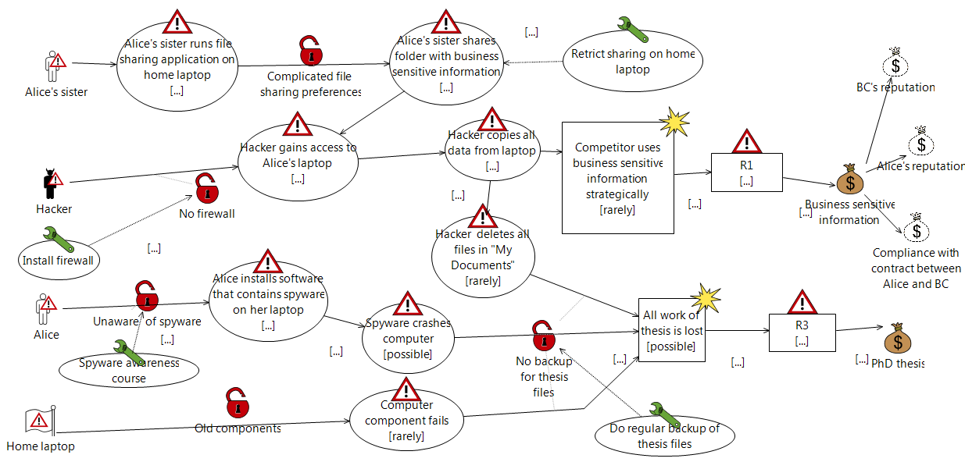
Example: Treatment Diagram
“treat” relation

Slide 57
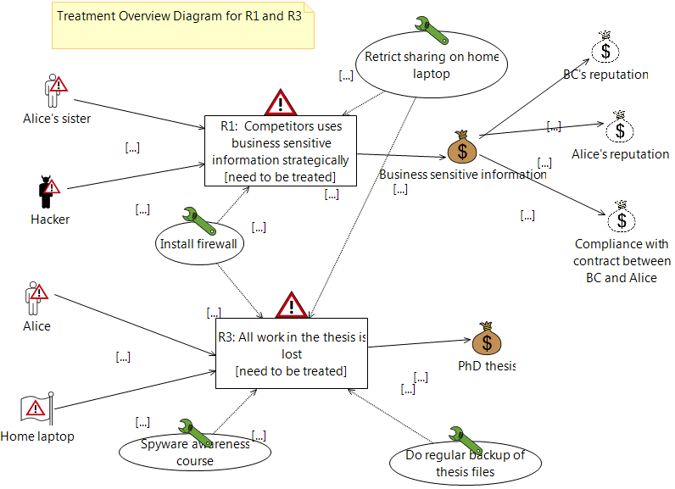
Example: Treatment Overview Diagram

Slide 58
Semantic
How to interpret and understand a CORAS diagram?
Users need a precise and unambiguous explanation of the meaning of a given diagram
Natural language semantics
CORAS comes with rules for systematic translation of any diagram into sentences in English
Formal semantics
Semantics in terms of a probability space on traces

Slide 59
Example
Elements
Computer virus is a non-human threat.
Virus protection not up to date is a vulnerability.
Threat scenario Server is infected by computer virus occurs with likelihood possible.
Unwanted incident Server goes down occurs with likelihood unlikely.
Availability of server is an asset.
Relations
Computer virus exploits vulnerability Virus protection not up to date to initiate Server is infected by computer virus with undefined likelihood.
Server is infected by computer virus leads to Server goes down with conditional likelihood 0.2.
Server goes down impacts Availability of server with consequence high.

Slide 60
Tool Support and Demo
The CORAS tool is a diagram editor
Support for making all kinds of CORAS diagrams
Design for on-the-fly modeling during structured brainstorming at analysis workshops
Ensures syntactically correct diagrams
Used during all steps of the risk analysis
Input to the various tasks
Gathering and structuring of information during the tasks
Documentation of analysis results
Available for download: http://coras.sourceforge.net/

Slide 61
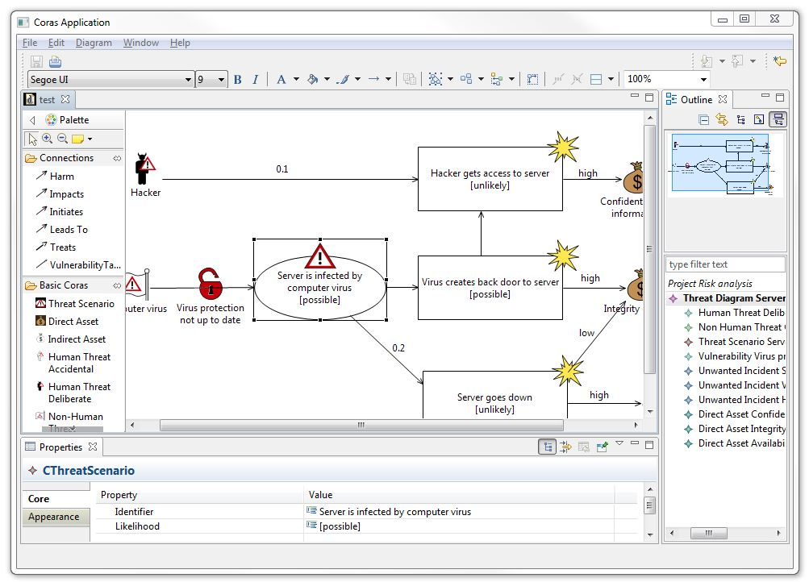
Tool Support: Screenshot
Tool bar
Pull-down menu
Palette
Outline
Canvas
Properties window

Slide 62
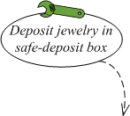
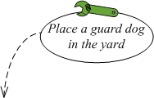
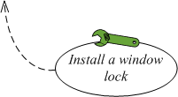
Summary
CORAS risk model in a nutshell
Remove threat
Reduce consequence
Threat scenario (initiated by threat)
Vulnerability
Unwanted incident
(leaded by threat scenario)
Threat
Remove vulnerability

Slide 63
Summary
CORAS consists of three parts
Method
Language
Tool
Model-driven and asset-driven
Concrete guidelines for how to conduct risk analysis in practice
Based on a well-established and precisely defined conceptual framework
Based on internationally established standards
Book: http://www.springer.com/computer/swe/book/978-3-642-12322-1
Home page: http://coras.sourceforge.net/

Slide 64
Credits
M.Lund, B.Solhaug, K.Stolen, Model-Driven Risk Analysis: The CORAS approach. Springer 2011.
Heidi E.I.Dahl, ESSCaSS 2008, NODES Tutorial.
Atle Refsdal, ERISE 2011 tutorial.

